Slide 1
Safe Web Development in Haskell
Final Project Presentation: Rajat Varma

Slide 2
Web development
Forms- a nightmare in web development
Injection attacks (SQL/Command)
No true type checking possible- everything is transferred across the web as a stream of bytes
Impossible to cover all edge cases

Slide 3
Web development in Haskell
Compiling code helps.
Know all possible errors with types and forms before the website runs
Forced referential transparency
Mitigate bad code practices: modifying critical data when not required
Type safe URLs
Singular definition of all URLs prevents having to change it in multiple locations
Data sent out is guaranteed to be well formed

Slide 4
GADTs
Form data type
data FormData = FormData {
field1 :: Type , field2 :: Type , field3 :: Type
} userForm :: Form App App UserData userForm = renderDivs $ UserData
<$> areq field1 "Name" Nothing <$> areq field2 "Email" Nothing <$> areq field3 "Age" Nothing

Slide 5
Form data type
Ensure data is valid.
Marshal string data in the form of submission to Haskell datatypes.
Generate HTML code for displaying the form.
Build up more complex forms by combining simpler forms.
Applicative, Monadic and Input forms
Input form used for maximum flexibility with styling: tradeoff choices.

Slide 6
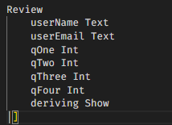
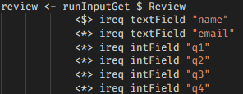
Form used
Field
Field
Field
EncType
Validation Logic
FormResult
Field
Field
FormMessage

Slide 7
Types in the Form
Text vs String
Validate numerical values: MsgInvalidInt

Slide 8
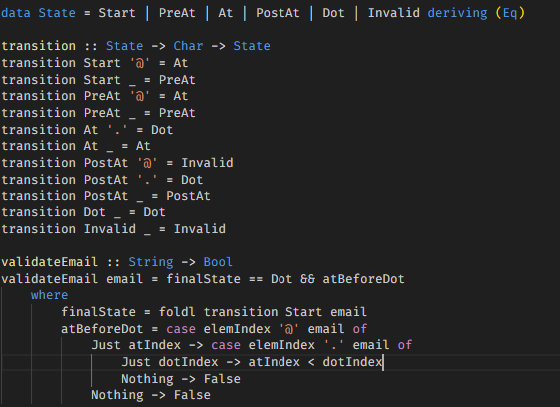
Email Validation
State machine used
1
@
2
.
3
Accept
end
@
Invalid

Slide 9
Working with SQL
SQLite and Persistent
Simple database mimicking the Review data type
Single query point: all data transferred between DB and Haskell
Name | Email | Q1 | Q2 | Q3 | Q4

Slide 10
Testing
Ability to handle any inputs/missing inputs
Ability to handle SQL injection
Using the Selenium webdriver to simulate user behaviour.
Random name of 10 letters + Random email
Email field used for SQL injection tests, email validation tests etc.
Random number for each of the 4 questions.

Slide 11
Testing
Webdriver opens a firefox instance and repeatedly generates random inputs and inputs them into the website.
Tried to simulate multiple instances at once, but was resource-constrained.

